Slide 1
Frontiers of Network Science
Fall 2023
Class 8:Introduction to Gephi:
Tools for Network Analysis and Visualization
Vijay Sadashivaiah*
*Adopted from Class 8 slides by Boleslaw Szymanski

Slide 2
Overview of tools for network analysis and visualization
Installing and using Gephi
Class Plan
Gephi hands-on lab exercises

Slide 3
Computing model and interfaces
Tool for network analysis and visualization
GUI or API/code libraries
Extensibility by the community (plugins)
Source code availability

Slide 4
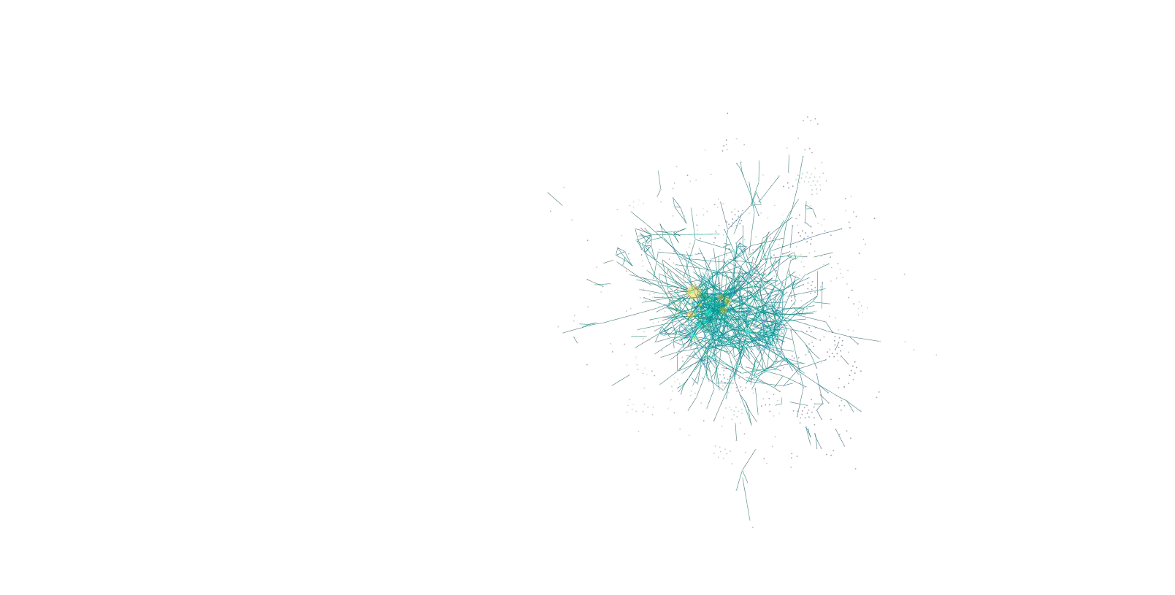
Cytoscape
https://cytoscape.org/
GUI application
Allows visualization and analysis of large complex networks
Originally developed for biological research
Several layout algorithms
Publication-quality images
Written in Java
Extensible through plugins
Free and open source
Windows, Linux, MacOS

Slide 5
Gephi
https://gephi.org/
GUI application
Allows visualization and analysis of large complex networks and dynamic networks
Clustering and community detection
Layout algorithms supported
Produces publication-quality images
Written in Java
Extensible through plugins
Free and open source
Windows, Linux, MacOS

Slide 6
Graphviz
https://graphviz.org/
Graph description language (called DOT) + tools to handle DOT files
Only performs drawing
Wide range of graph layouts
Written in C
Extensible through a scripting API
Free and open source

Slide 7
Neo4J
https://neo4j.com/
Graph Database
Efficient management of semi-structured and network-oriented data
Robust – ACID transactions, transaction recovery
Highly scalable
High performance – query optimizer, index-free adjacency
Free

Slide 8
Pajek and Pajek-XXL
http://mrvar.fdv.uni-lj.si/pajek/
GUI application
Network generator (Random, Bernoulli/Poisson, Scale-
free, etc.)
Capable of analyzing and visualizing large networks
Free (noncommercial)
Windows only

Slide 9
NetworkX
https://networkx.github.io/
Python library
Creation, manipulation and analysis of networks
Supports various network formats
Provides standard graph algorithms
Network analysis and generation
Visualization with Matplotlib and Graphviz
Free and open source

Slide 10
SNAP
http://snap.stanford.edu/index.html
C++ library – Python interface is
available
Scales to massive networks with hundreds of millions of nodes
Efficiently manipulates large graphs
Available through NodeXL – graphical front-end that integrates network analysis into Microsoft Office

Slide 11
Installing Gephi
Download it from https://gephi.org/
Current version is 0.9.5 (May 3 2022)
Requires the Java Runtime Environment (JRE) 7 or 8
Important: By default, Gephi is configured to start with 512 MB of memory allocated to the JVM. This might not be enough for larger graphs. To increase the memory allocated to the JVM, change the –Xmx option in file gephi.conf (e.g., set –Xmx1024m) then close and reopen Gephi for the new options to take effect.
Notes:
How to edit gephi.conf:
On Windows, go to the Gephi folder in Start menu and click on Startup Settings. Edit this file with Notepad or WordPad. Alternatively, go in C:\Program Files (x86)\Gephi 0.9.3\etc\gephi.conf and edit file manually.
On Mac OS X, right-click on Gephi application icon and select Show Package Contents to open a new Finder window displaying a Contents folder. Open the Contents folder, and then open the Resources/gephi/etc folder, in which the gephi.conf file resides. Use TextEdit to edit the file.
On Linux, go into your application directory and then into the etc folder. Edit the file with a text editor.

Slide 12
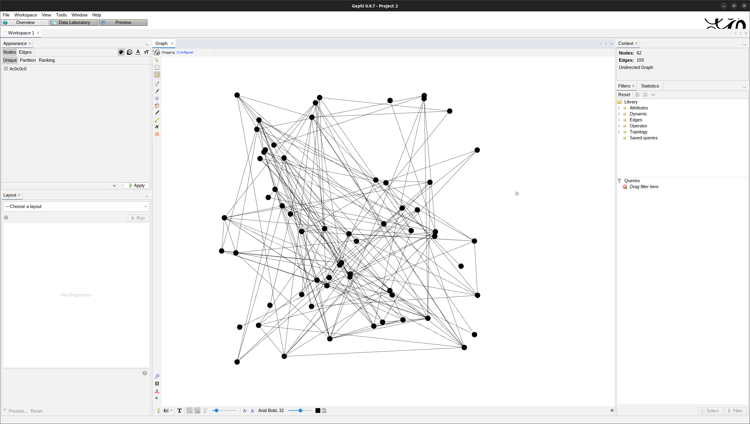
Work mode
Overview – general overview (current)
Data Laboratory – Table-like view
Preview – Preview and adjust the final image
Appearance – change node/edge color and size based on partition or ranking of attributes
Layout options – change layout algorithm and parameters
Filters – show/hide nodes and edges based on attributes
Statistics – compute a number of network statistics (degree distribution, diameter, centrality, etc.)

Slide 13
Sample Network: Les Misérables
This network comes with Gephi version 0.9.5*
Based on Victor Hugo's novel Les Misérables
Nodes represent characters, edge represent the co-occurrence of characters in the same chapter
Directed or undirected?
Could there be edge weights?
* Also available from http://www.casos.cs.cmu.edu/computational_tools/datasets/external/lesmi s/

Slide 14
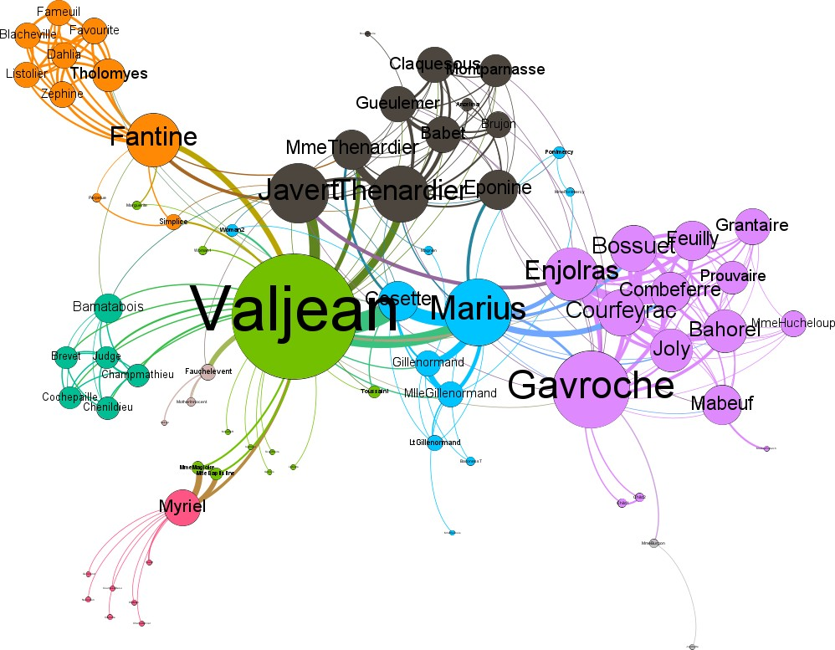
Step by step for creating a network visualization in Gephi
Node color: partition (modularity)
Node size: degree
Edge width: co-occurrence
What is modularity?
The novel was published in 5 volumes

Slide 15
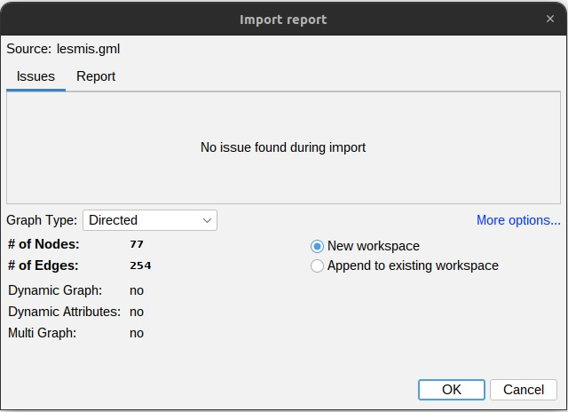
Download and open the network file
Download the GML file from http://www.casos.cs.cmu.edu/comput ational_tools/datasets/external/lesmis
/
In Gephi, go to File > Open and find
the downloaded file.
Check the import report to see if inferred attributes are correct
Is it?

Slide 16
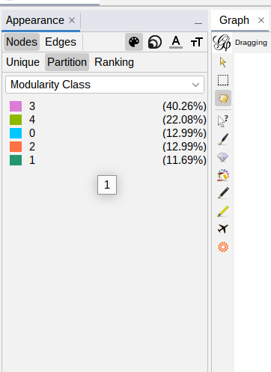
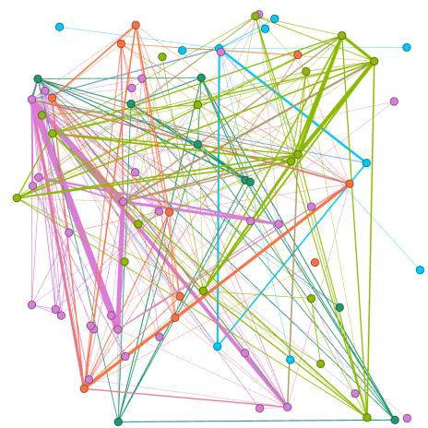
Changing the color and size of nodes
First, we need to compute some attributes
Go to the Statistics menu and run Average Degree and
Modularity calculations
In the menu, select the Partition tab and choose
Modularity Class from the dropdown menu
Click on the Apply button
Why Partition?
Partition is normally used to distinguish between categorical
variables, when the values are not in a scale

Slide 17
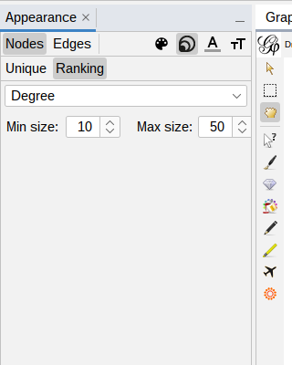
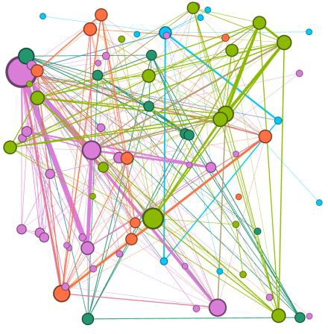
Changing the color and size of nodes
Switch to the node size Appearance options
Select the Ranking tab and choose Degree from the dropdown menu
Set the Min size to 10 and Max size to 50
Click on Apply
Notice the change in the node size
Why Ranking?
When values are not categorical and have an ordering, ranking can be used to represent node size

Slide 18
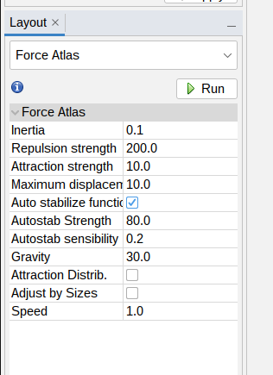
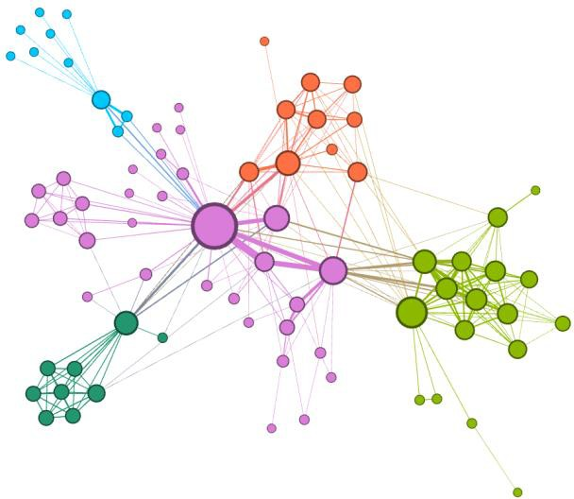
Applying a layout
Nodes do not inherently have a position in a 2D plot
Layouts use node and edge attributes to produce more meaningful displays of the network
In the Layout menu, select the Force Atlas 2 algorithm from the dropdown list and click on Run
Click on Stop to pause the algorithm as it may not
converge to a solution
Repeat it but now set the Scaling attribute to 100 and select the Prevent Overlap option

Slide 19
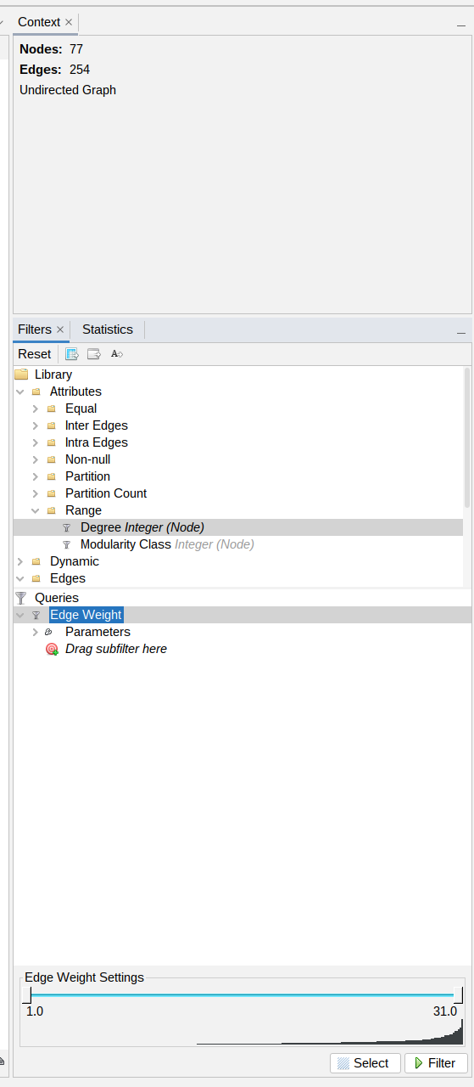
Filtering nodes and edges
Nodes and edges can be filtered based on their attributes to provide clearer visualization
Examples of filter options are: node degree, edge weight, modularity class
To create a filter, go to the Filters menu, select a filtering option and an attribute, for example, Edge Weight
Adjust the filter to include the range of interest and click on the Filter button
To stop the filter and revert back, click on Stop
Multiple filters can be combined to create complex queries

Slide 20
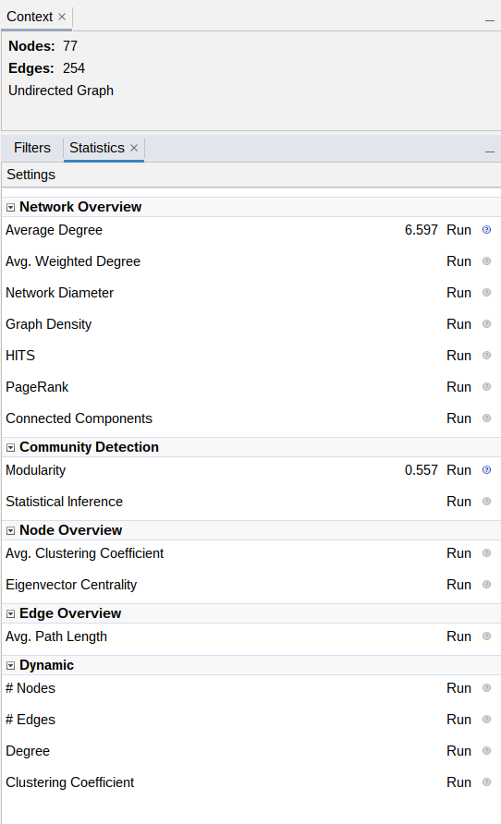
Network statistics
Degree – the number of edges incident to a node (in/out degree available for directed graphs)
Betweenness centrality – the number of shortest paths from all nodes to all other nodes that pass through that node
Closeness centrality – sum of the shortest paths from a node to all other nodes
Eccentricity – the greatest distance between a node and any other node in the network
Diameter – the longest shortest path between any
nodes
Many other metrics are available, and even more can be loaded as plugins

Slide 21
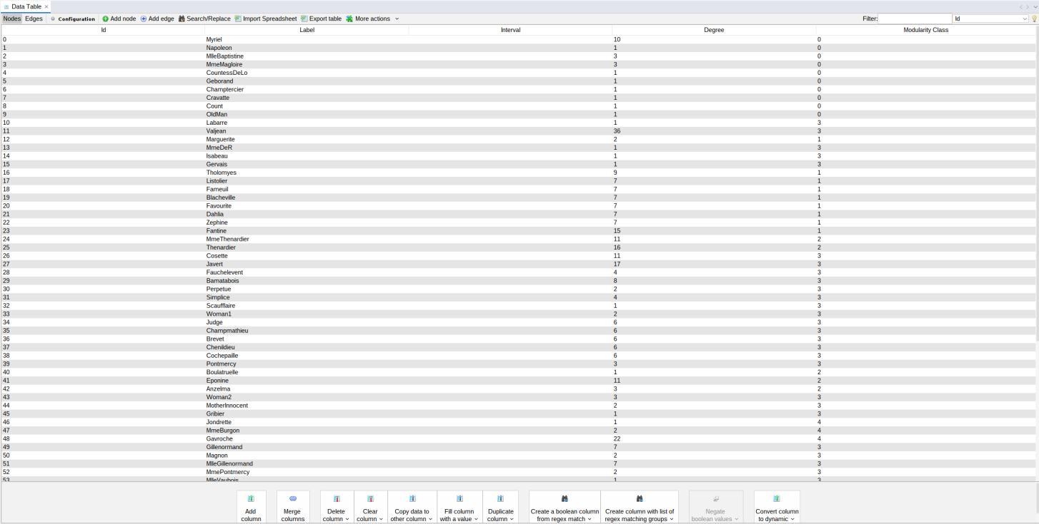
Data Table
A table view of the data can be seen in the Data Table menu
Data can be edited
Nodes and edges can be created or deleted
Can import data from spreadsheets

Slide 22
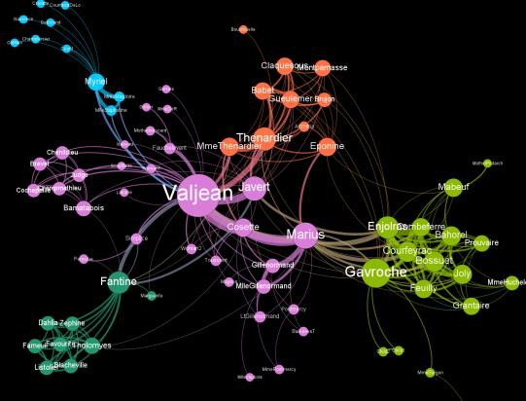
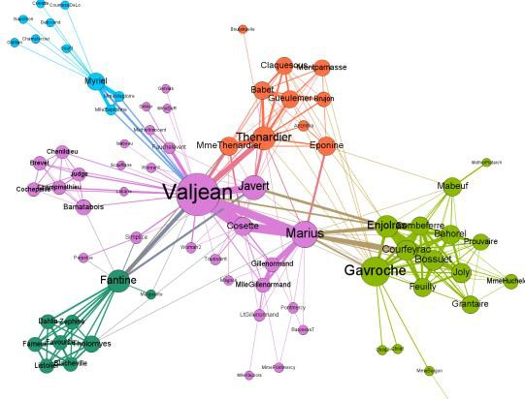
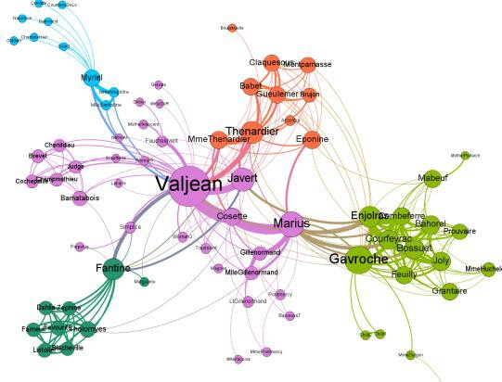
Rendering a graph to export
Dark background
The Preview menu allows you to do some final
adjustments to the final product
Default presets are available, custom presets can be created
Possible adjustments: show node labels, draw borders, show edges, define edge shape (straight/curved), etc.
Remember to click on Refresh to update the preview
To export the figure go to File > Export > SVG/PDF/PNG...
For publication, export vector images such as SVG and
PDF
Default straight
Default curved

Slide 23
PDF
SVG
PNG
CSV
GDF
GEXF
GML
GraphML
UCINET DL
Pajek NET
Netdraw VNA
Spreadsheet
Export Formats - Gephi

Slide 24
Import the network – remember to check if the inferred parameters
are correct (e.g., directed/undirected networks)
Import
Compute the desired attributes from the Statistics menu (degree, centrality, modularity, etc.)
Attributes
Gephi workflow
Apply the Appearance options based on the attributes
Appearance
Filter out nodes and edges to clear the clutter and highlight the important aspects of the network
Filter
Export
Export the result (either as a figure or as structured data)

Slide 25
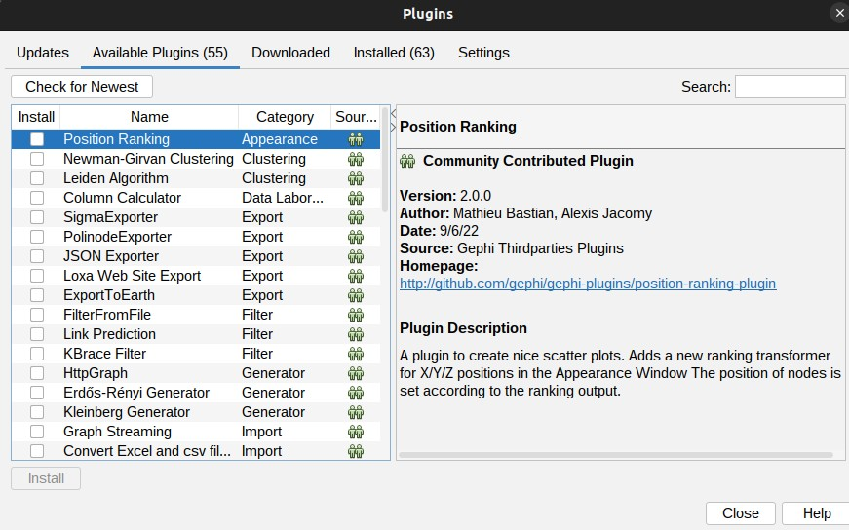
Plugins
A number of plugins are available for Gephi
These can be found and installed in Tools > Plugins

Slide 26
References
Bastian, Mathieu, Sebastien Heymann, and Mathieu Jacomy. "Gephi: an open source
software for exploring and manipulating networks." ICWSM 8 (2009): 361-362.
Cherven, Ken. Network graph analysis and visualization with Gephi. Packt Publishing Ltd,
2013.
Cherven, Ken. Mastering Gephi network visualization. Packt Publishing Ltd, 2015..
Gephi additional tutorial slides are available at: https://www.slideshare.net/GraceBenefield/basics-gephi-tutorial
More publications are listed at: https://gephi.org/users/publica
Khokhar, Devangana. Gephi Cookbook. Packt Publishing Ltd, 2015
Sample Gephi datasets are available at: https://github.com/gephi/gephi/wiki/Datasets

Slide 27
Exercises

Slide 28
Exercise 1
In this exercise you will:
Review network statistics in Gephi
Practice setting up network analysis using different metrics
Task: Compute three measures for each of the following networks:
Dolphins Social Network in New Zealand: http://www- ersonal.umich.edu/~mejn/netdata/dolphins.zip
Erdős Collaboration Network: http://vlado.fmf.uni- lj.si/pub/networks/data/
Network | # of nodes | # of edges | Density | # of triangles | Diameter
Dolphins | 62 | 159
Erdős | 6,927 | 11,850
Notes:
Dolphins: 0.084, 95, 8
Erdos: 0, 5973, 4

Slide 29
Exercise 2
Using the following networks (five in total), compute the attributes
https://snap.stanford.edu/data/oregon1.html
https://snap.stanford.edu/data/oregon2.html
https://snap.stanford.edu/data/email-Enron.html
Network | # of nodes | # of edges | Average node degree (<k>) | # of triangles (∆) | Diameter (D)
Autonomous systems - Oregon-1- 010407¹ | 10,729 | 21,999
Erdős Collaboration Network | 6,927 | 11,850
Autonomous systems - Oregon-1- 010331¹ | 10,670 | 22,002
Autonomous systems - Oregon-2- 010331² | 10,900 | 31,180
Enron Giant Component³ | 33,696 | 180,811
Notes:
4,101,

Slide 30
Exercise 3
Review the layout algorithm and visualization parameters for the following networks, then, create a publication quality vector image (SVG/PDF) for them
http://vlado.fmf.uni-lj.si/pub/networks/data/ucinet/ucidata.htm#zachary
http://www-personal.umich.edu/~mejn/netdata/
http://snap.stanford.edu/data/amazon0302.html
Network | # of nodes | # of edges
Zachary Karate Club¹ | 34 | 78
American College Football² | 115 | 613
Amazon product co-purchasing³ | 262,111 | 1,234,877

